Slide 1

Network Layer: IP Addressing
Lecture 7 | CSE421 – Computer Networks
Department of Computer Science and Engineering School of Data & Science

Slide 2
Objectives
IPv4 Address
Structure
Subnet/Prefix Mask
Types of IPv4 Address
IPv6 Address
Structure

Slide 3
Anatomy of IPv4

Slide 4
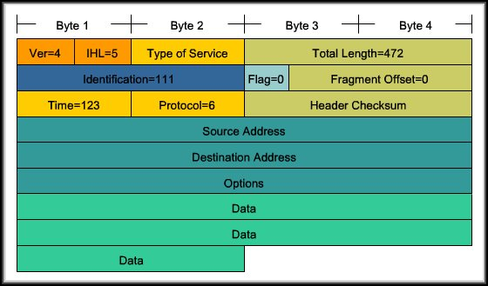
Anatomy of an IPv4 Address
Each device on a network must be uniquely identified at the Network layer.
For IPv4, a 32 bit source and destination address is contained in each packet.
For the transport layer, we’ve headers like TCP header and UDP header
Similarly for the network layer we also have IP header
This is a IPV4 header example

Slide 5
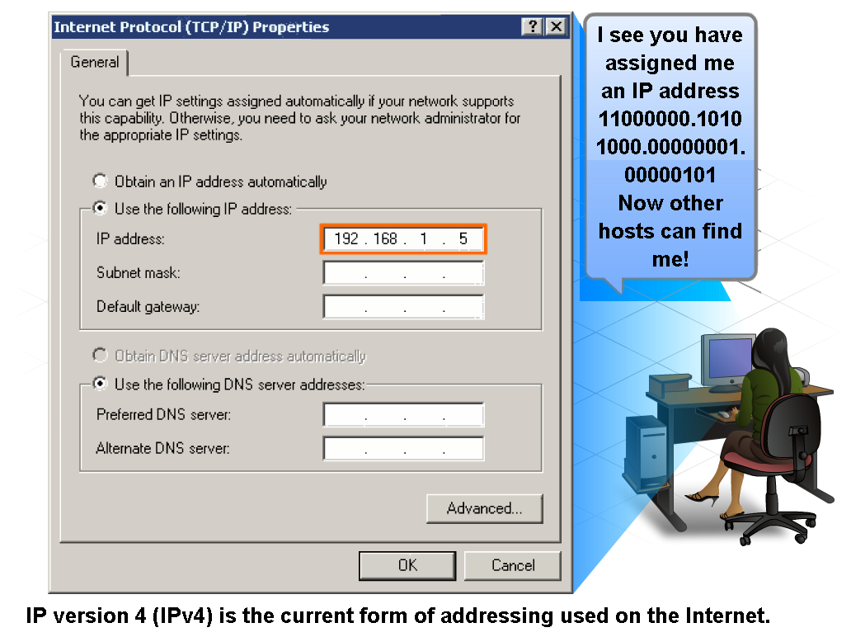
IPv4 Addressing Structure

Slide 6
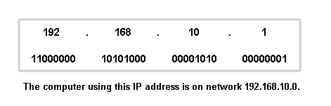
Anatomy of an IPv4 Address
Dotted decimals
Network part
Host part
32 bits
Divided into 4 Octets

Slide 7
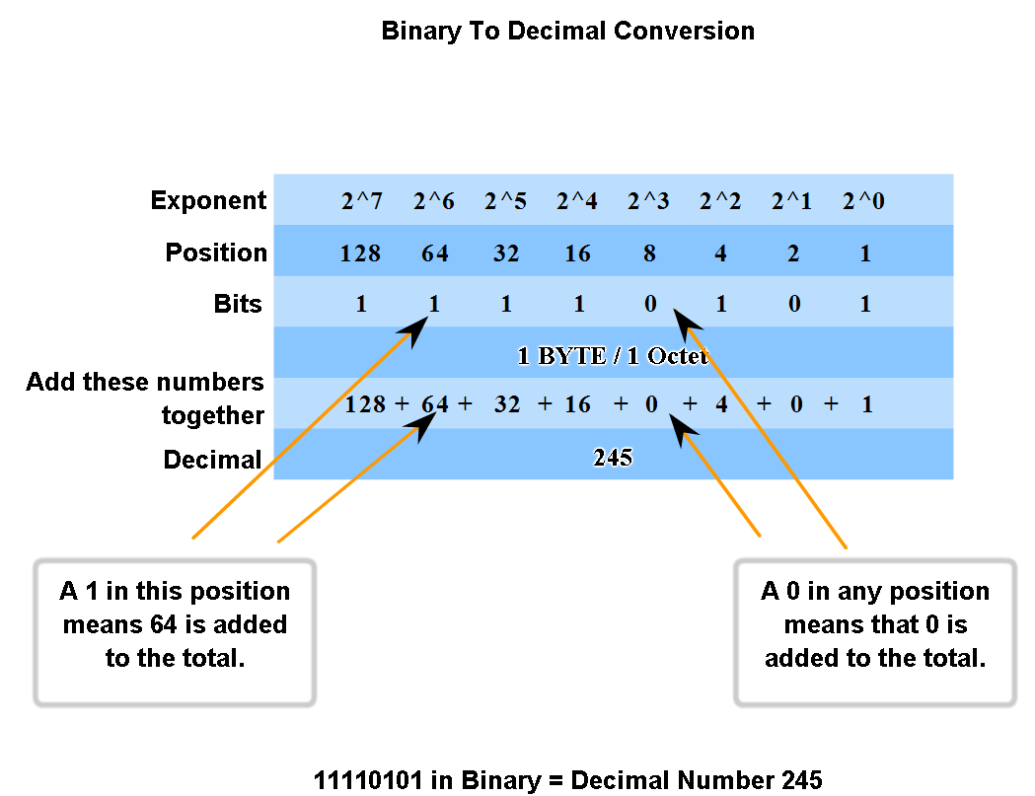
Binary to decimal and Vice Versa

Slide 8
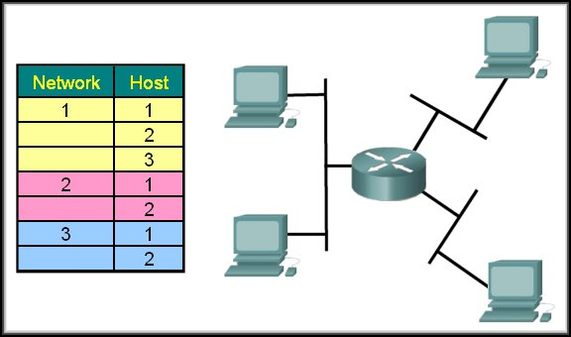
Networks and Hosts
To identify a path or "route" through a network, the address must be composed of two parts:
Network portion
Host portion
2.2
1.2
2.1
1.1
1.3
3.1
3.2

Slide 9
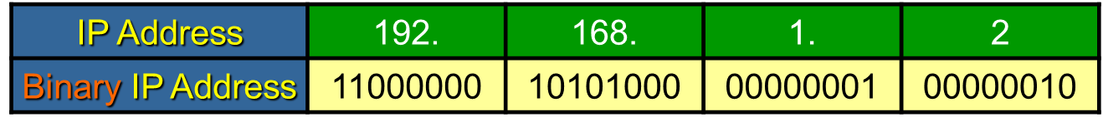
Network Portion
Network Portion:
Some portion of the high-order bits
A network can be defined as a group of hosts that have identical bit patterns in the network address portion of their addresses.
192.168.1.2 | 11000000 | 10101000 | 00000001 | 00000010
192.168.1.67 | 11000000 | 10101000 | 00000001 | 01000011
192.168.1.204 | 11000000 | 10101000 | 00000001 | 11001100

Slide 10
Network Portion
Host Portion:
A variable number of least significant bits that are called the host portion of the address.
The number of bits used in this host portion determines the number of hosts that we can have within the network.
192.168.1.2 | 11000000 | 10101000 | 00000001 | 00000010
192.168.1.67 | 11000000 | 10101000 | 00000001 | 01000011
192.168.1.204 | 11000000 | 10101000 | 00000001 | 11001100

Slide 11
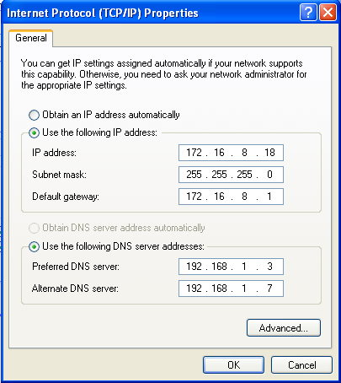
Prefix Mask
How do we or devices identify the network part or the host part?
Answer: Using the “Prefix Mask”.
192.168.10.2/24
Means that the first 24 bits are the network portion.
The last 8 bits are the host portion.
Subnet Mask; the other form of “Prefix Mask”.
Prefix length of /24 means a subnet mask of 255.255.255.0

Slide 12
Subnet Mask
The Prefix Mask and the Subnet Mask are different ways of representing the same information.
Conversion:
Subnet mask has the same format as an IP address. Hence, it has 32 bits divided into 8 bits (octets)
Prefix mask of /24 means, the first (MSB) 24 bits of subnet mask would be 1 and the rest will be 0
Decimal: 255 . 255 . 255 . 0
Binary: 11111111.11111111.11111111.00000000
Examples:
Prefix Mask of /24 or a subnet mask of 255.255.255.0
Prefix Mask of /16 or a subnet mask of 255.255.0.0
Prefix Mask of /8 or a subnet mask of 255.0.0.0

Slide 13
Exercise
What’s the subnet mask of the following?
IP Address: 10.24.36.2 / 4
IP Address: 10.24.36.2 / 12
IP Address: 10.24.36.2 / 16
IP Address: 10.24.36.2 / 23
What’s the prefix mask of the following?
IP Address: 10.24.36.2; Subnet Mask: 255.255.224.0
IP Address: 10.24.36.2; Subnet Mask: 255.255.255.192
IP Address: 10.24.36.2; Subnet Mask: 255.255.255.252
IP Address: 10.24.36.2; Subnet Mask: 255.254.0.0
IP Address: 10.24.36.2; Subnet Mask: 255.255.240.0

Slide 14
ANDing the Binaries
Inside data network devices, digital logic is applied for their interpretation of the addresses.
AND is used in determining the network address.
0 AND 0 = 0
1 AND 0 = 0
1 AND 1 = 1
0 AND 1 = 0
 | Decimal | Binary
IP Address | 135.15.2.1 | 10000111 00001111 00000010 00000001
Subnet Mask | 255.255.0.0 | 11111111 11111111 00000000 00000000
Network Address | 135.15.0.0 | 10000111 00001111 00000000 00000000

Slide 15
But Why AND?
Routers use the ANDing process to determine the route a packet will take.
The network number of the destination IPv4 address is used to find the network in the routing table.
The router then determines the best path for the frame.

Slide 16
IPv4 Addresses
Broadcast Address
Network Address
Host Address

Slide 17
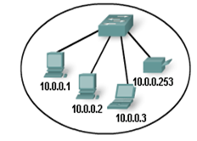
The Addresses
Network Address
All hosts in the network will have the same network bits.
Cannot be assigned to a device.
All host bits in this address will be zero.
10.0.0.0/24
IP Address | 10. | 0. | 0. | 0
IP Address in Binary | 00001010 | 00000000 | 00000000 | 00000000
Network Part
Host Part

Slide 18
The Addresses (Example)
For an IP address:
162.120.184.35 / 12
What is the Subnet mask ?
What is the network address ?
Solution:
IP address = 10100010 . 01111000 . 10111000 . 00100011
Prefix mask is : 12, means first 12 bits of the subnet mask is 1, all other bits are 0.
Subnet mask: 11111111 . 11110000 . 00000000 . 00000000
= 255 . 240 . 0 . 0
Network Address: Bit by bit Logical AND of IP address and Subnet mask
= 162 . 112 . 0 . 0

Slide 19
The Addresses
Host Address
The unique address assigned to each device on the network.
For a network of 10.0.0.0/24
Addresses 10.0.0.1 through 10.0.0.254 are
All host bits in this address will vary.
Host Address
Why 254, why not 255 ?
IP Address | 10. | 0. | 0. | 1
IP Address in Binary | 00001010 | 00000000 | 00000000 | 00000001
Network Part
Host Part
IP Address | 10. | 0. | 0. | 3
IP Address in Binary | 00001010 | 00000000 | 00000000 | 00000011

Slide 20
The Addresses
Host Address
The unique address assigned to each device on the network.
For a network of 10.0.0.0/24
Addresses 10.0.0.1 through 10.0.0.254 are
All host bits in this address will vary.
BROADCAST ADDRESS
Why 254, why not 255 ?

Slide 21
The Addresses
Broadcast Address
Used to send message to all hosts in the network using one single address
Cannot be assigned to a device.
All host bits in this address will be one.
Broadcast Address of 10.0.0.0/24 network is 10.0.0.255/24
IP Address | 10. | 0. | 0. | 255
IP Address in Binary | 00001010 | 00000000 | 00000000 | 11111111
Network Part
Host Part

Slide 22
The Addresses (Example)
For an IP address:
162.120.184.35 / 12
What is the Broadcast Address?
Solution: For, 162.120.184.35 / 12 , First 12 bits are for network bits and later 20 bits are host bits. So, for broadcast all the host bits will be 1.
Ip = 10100010 . 01111000 . 10111000 . 00100011
Broadcast IP = 10100010 . 01111111 . 11111111 . 11111111
= 162 . 127 . 255 . 255

Slide 23
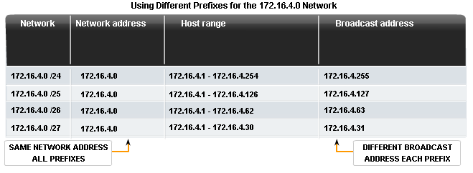
Network Prefix
The network prefix is not always /24.

Slide 24
Types of IPv4 Addresses

Slide 25
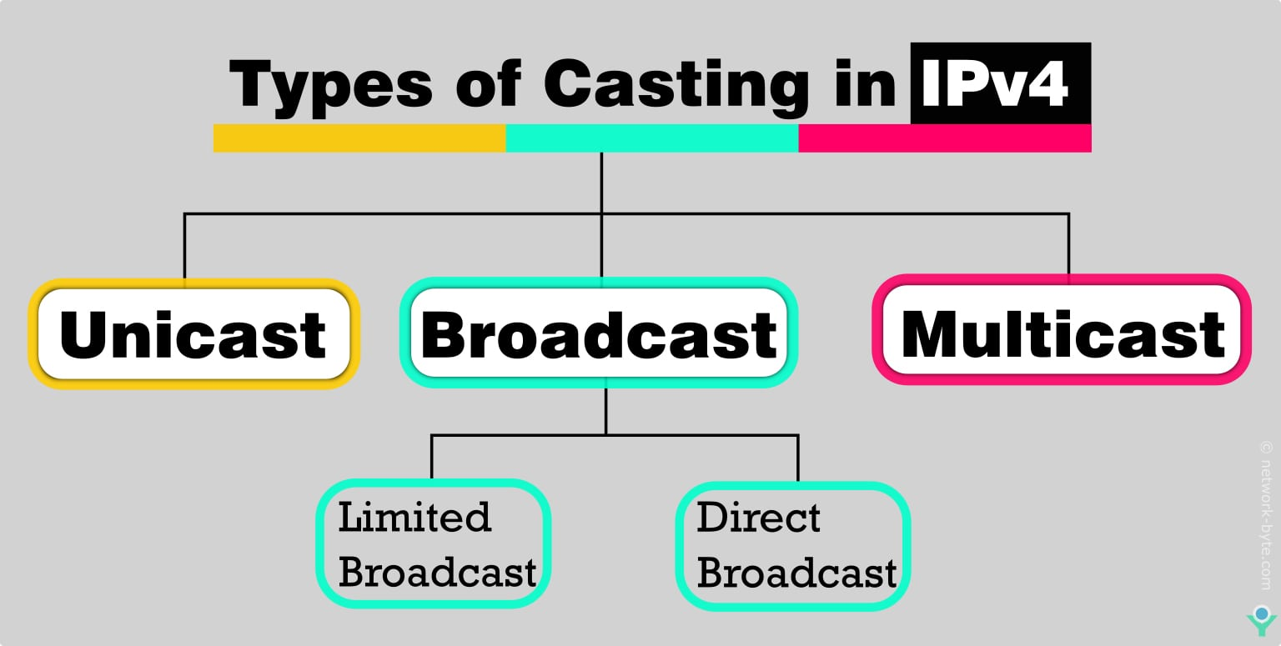
Special Addresses

Slide 26
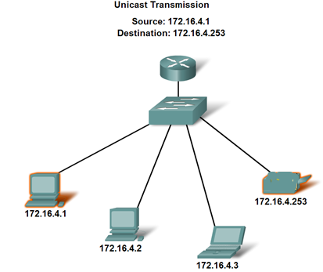
Unicast
Unicast
A message to one host.
Individual IPv4 addresses
Packet
172.16.4.253 | 172.16.4.1 | Data
Dest IP Add | Source IP Add | Packet

Slide 27
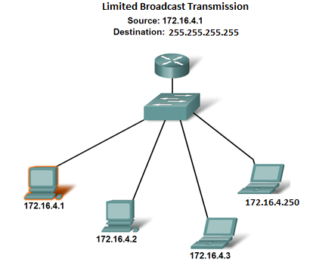
Broadcast
Limited Broadcast
A message to all hosts on the same physical/local network or subnet.
255.255.255.255
Never forwarded by routers!
Packet
Packet
Packet
Packet
Packet
Note the destination Address
255.255.255.255 | 172.16.4.1 | Data
Dest IP Add | Source IP Add | Packet

Slide 28
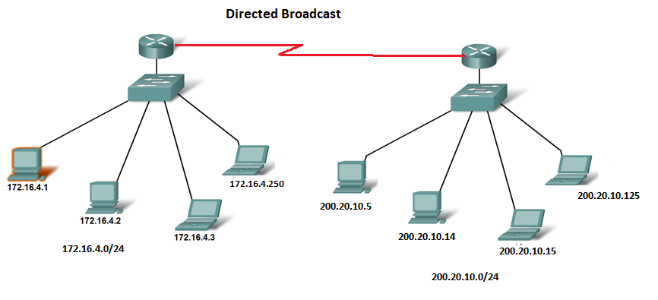
Broadcast
Directed Broadcast
A message to all hosts on a different network or subnet.
broadcast address of a network
Example : 200.20.10.255
Packet
Packet
Packet
Packet
Packet
Packet
Packet
 | 172.16.4.1 | Data
200.20.10.255
Note the destination Address
Dest IP Add | Source IP Add | Packet

Slide 29
Multicast
Multicast Addresses
A message addressed to a group of hosts.
Analogy:
A person (host) must have a unique name (Unicast IP).
He can also join a club (Multicast Group IP).
So, the host that joined the group actually listens to two ip addresses.
If the destination ip = unicast ip, only the host listens the message
if the destination ip = group ip, the hosts in the group listens the message.

Slide 30
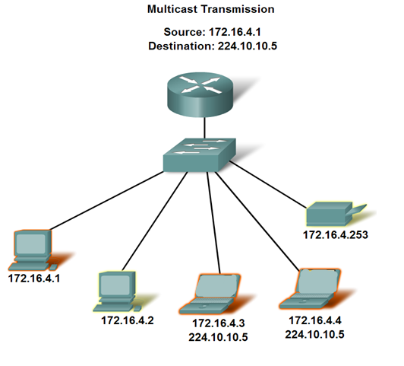
Multicast
Multicast Addresses
A message addressed to a group of hosts.
The group ip addresses must start within this range of 224 - 239.
Multicast Group IP range:
224.0.0.0 to 239.255.255.255.
Packet
Packet
Examples of Multicast Application
Video and audio broadcasts
Distribution of software
News feeds
Packet
224.10.10.5 | 172.16.4.1 | Data
Dest IP Add | Source IP Add | Packet

Slide 31
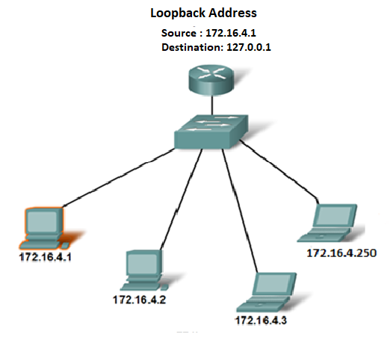
Loopback
Loopback Address
A special IP address that a device uses to send data to itself
When traffic is sent to this address, it never leaves the host and never touches the physical network hardware like the switch.
Testing and Troubleshooting purpose
Loopback Range:
127.0.0.0 to 127.255.255.255
Packet
127.0.0.1 | 172.16.4.1 | Data
Dest IP Add | Source IP Add | Packet
Notes:
It allows applications to communicate with each other within the same host without requiring physical network hardware or connectivity.
The loopback address is often used for troubleshooting network issues, testing server applications, or ensuring that network software is functioning as expected locally.
Characteristics: Packets sent to a loopback address never leave the host device; they are routed internally, ensuring no external network traffic is involved.

Slide 32
Anatomy of IPv6 Address

Slide 33

Reasons for using IPv6
Address Availability:
IPv4: 32 bits - 4 octets
2^32 or 4,294,467,295 IP Addresses.
IPv6: 128 bits - 16 octets
2^32
3.4 x 10^38 or
340,282,366,920,938,463,463,374,607,431,768,211,456
(340 undecillion) IP Addresses.
Every grain of sand on every beach on Earth could be assigned over a million unique IPv6 addresses, with plenty to spare (assuming approximately 7.5 x 10^18 grains of sand globally and 2^128 IPv6 addresses).

Slide 34
IPv6 Address
128 bits
given below is a 128 bit IPv6 address represented in binary format and divided into eight 16-bits blocks
Each 4 bits is converted into a Hexadecimal digit
Each block contains 4 Hexadecimal digits
Each block is separated by ‘:’ symbol

Slide 35
IPv6 Address
2
0
0
1
Called string notation

Slide 36
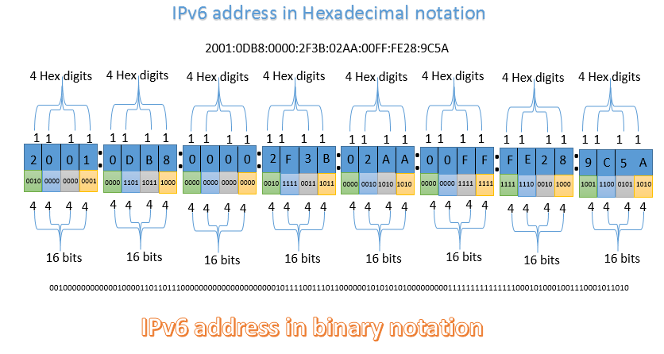
IPv6 Address
Notes:
This is just for the students

Slide 37
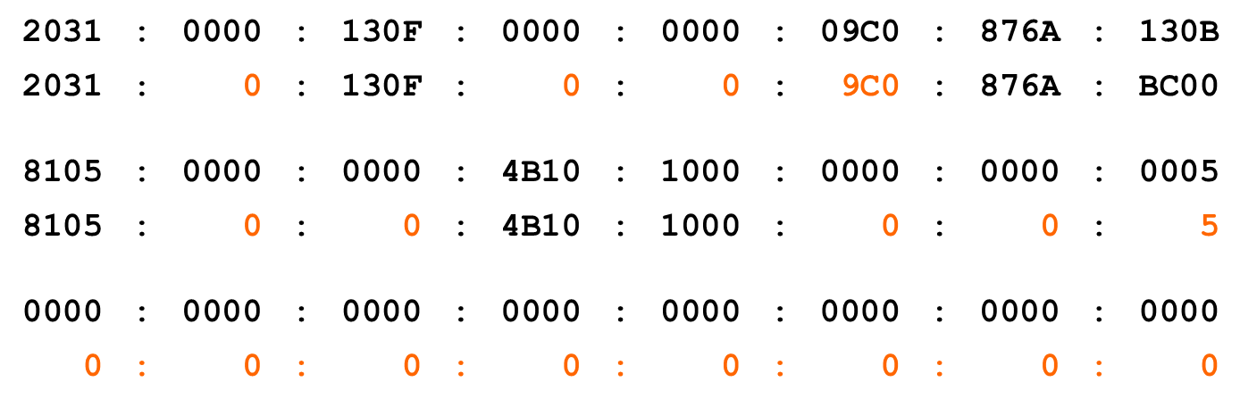
IPv6 Addressing
IPv6 Representation – Rule 1:
The leading zeros in any 16-bit segment do not have to be written.
If any 16-bit segment has fewer than four hexadecimal digits, it is assumed that the missing digits are leading zeros.
130B

Slide 38
IPv6 Addressing
IPv6 Representation – Rule 2:
Any single, contiguous string of one or more 16-bit segments consisting of all zeroes can be represented once with a double colon.
you can only use the double colon (::) once per address.
1080:0:0:0:8:800:200C:417A | = | 1080::8:800:200C:417A
FF01:0:0:0:0:0:0:101 | = | FF01::101
0:0:0:0:0:0:0:1 | = | ::1
0:0:0:0:0:0:0:0 | = | ::
17

Slide 39
IPv6 Addressing
IPv6 Representation – Rule 2:
Example: 1843::22::fa
Illegal because the length of the two all-zero strings is ambiguous.
1843:0000:0000:0000:0022:0000:0000:00fa
1843:0000:0000:0022:0000:0000:0000:00fa
or
18

Slide 40
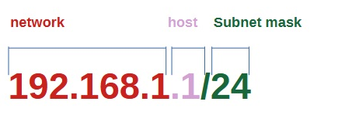

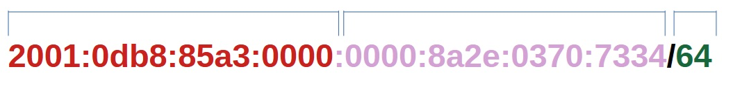
Representing IPv6 addresses
IPv4 Address
IPv6 Address
No Subnet masks in dotted decimal format in IPv6

Slide 41
The End

